Slide 1
Rising leaders conference
National Press Club
Washington, D.C.
May 16, 2017

Slide 2
The Election of 2016…
Government Relations & Advocacy
Donald J. Trump
President of the United States

Slide 3
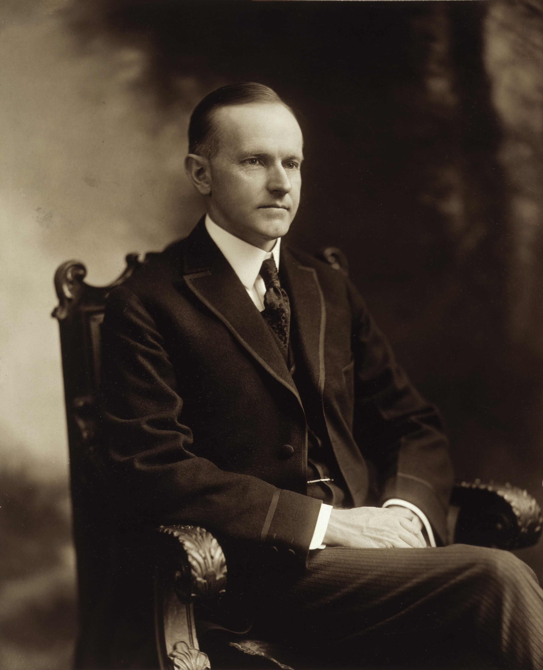
The most business friendly administration since…
Government Relations & Advocacy
Calvin Coolidge
“The Business of America is Business.”

Slide 4
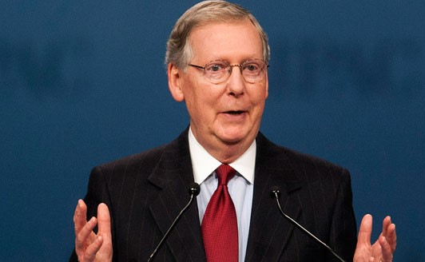
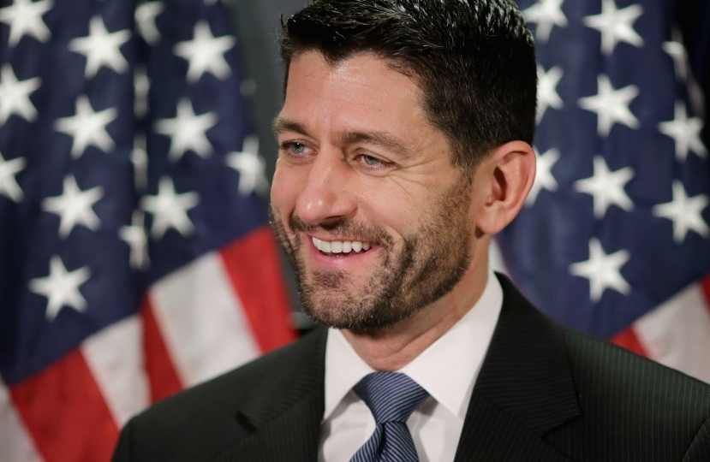
The Republican Congress…
Government Relations & Advocacy
Sen. Mitch McConnell (R-KY)
Senate Majority Leader
Rep. Paul Ryan
(R-WI)
Speaker of the House

Slide 5
Original Timetable…
Government Relations & Advocacy
Health Care Reform
Tax Reform
Infrastructure
Regulatory Relief

Slide 6
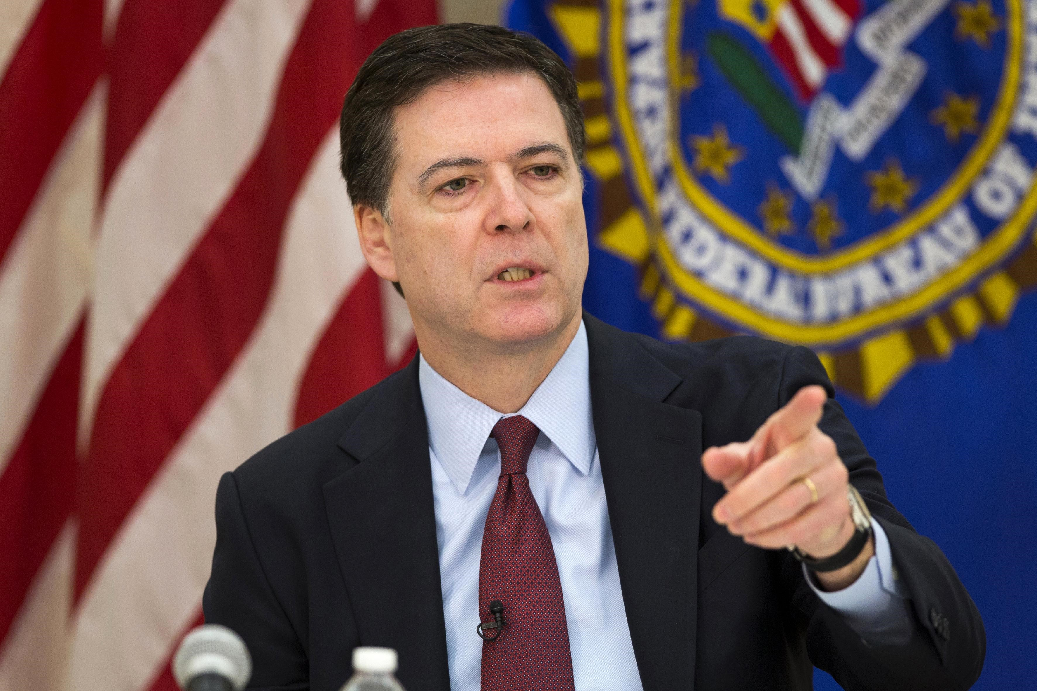
Fatal Distractions…
Government Relations & Advocacy
James B. Comey

Slide 7
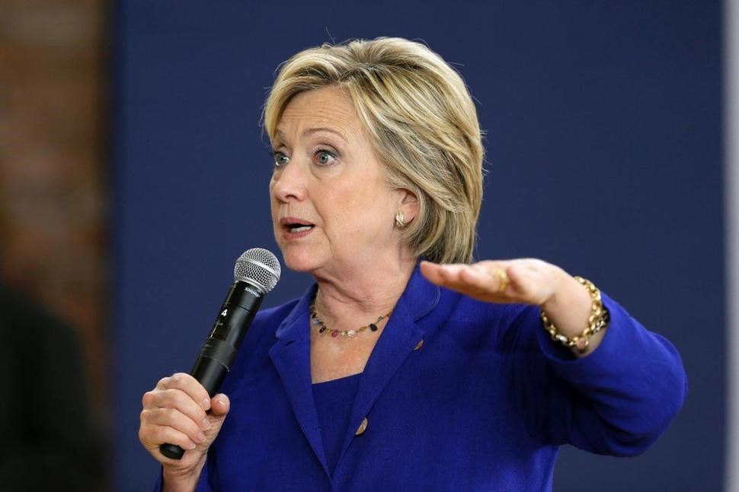
Government Relations & Advocacy

Slide 8
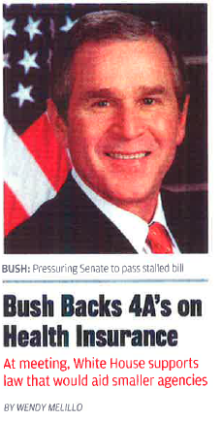
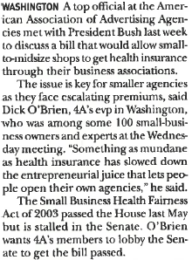
Government Relations & Advocacy
Health Care Reform…

Slide 9
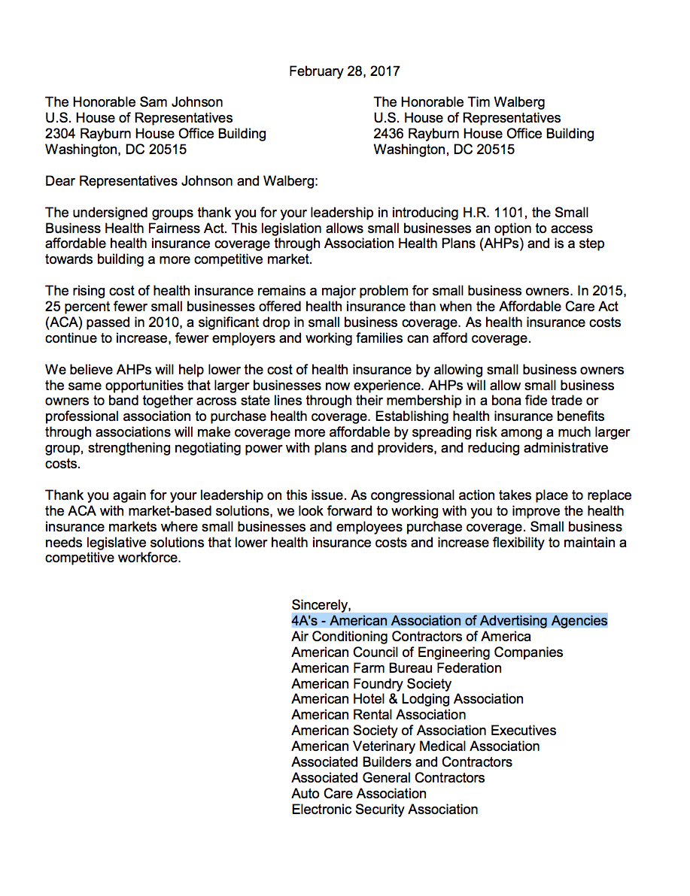
ASSOCIATION HEALTH PLANS
Government Relations & Advocacy

Slide 10
CORPORATE TAX REFORM
Government Relations & Advocacy
Border-adjustable Cash-flow Tax (BACFT)
Reduce tax rate from 35% to 20%
Applies to domestic consumption only
Sales of imports consumed domestically are taxed
Sales on exports consumed overseas are not taxed
Business investments are deductible

Slide 11
The Alternative Approach…
Government Relations & Advocacy
The Camp/Baucus Plan
Advertising: 50% Deductible; 50% Amortized
The Impact: $169 Billion over ten years

Slide 12
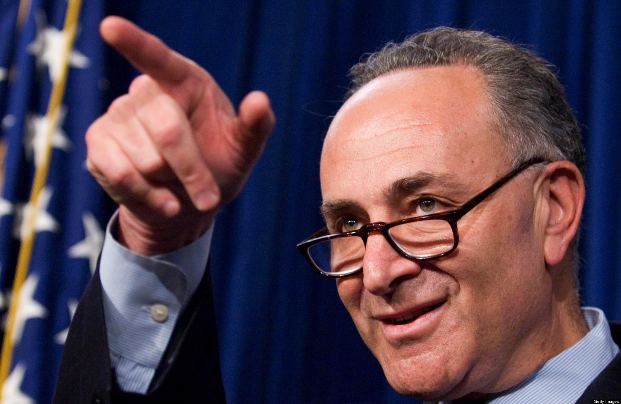
Corporate Tax Reform…
Government Relations & Advocacy
Sen. Chuck Schumer(D-NY)
Senate Minority Leader
“Over My Dead Body…”

Slide 13
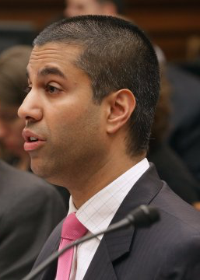
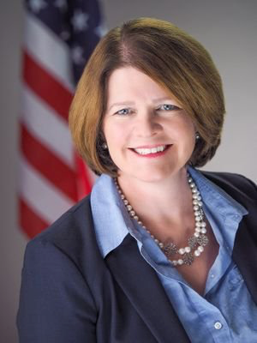
REGULATORY RELIEF
Government Relations & Advocacy

Slide 14
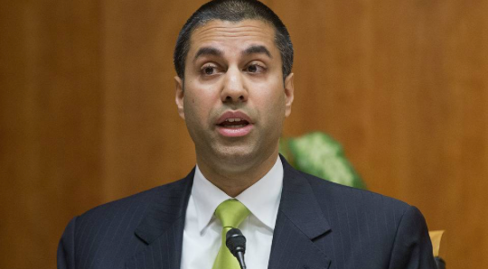
Government Relations & Advocacy
By ALEXANDRA BRUELL – March 24, 2017 8:04 am ET
WASHINGTON — The Senate voted Thursday to allow wireless and Internet service providers such as Verizon, Comcast and AT&T to share customers’ online data with advertisers without consent, a step toward reversing regulations the Federal Communications Commission enacted

Slide 15
Government Relations & Advocacy

Slide 16
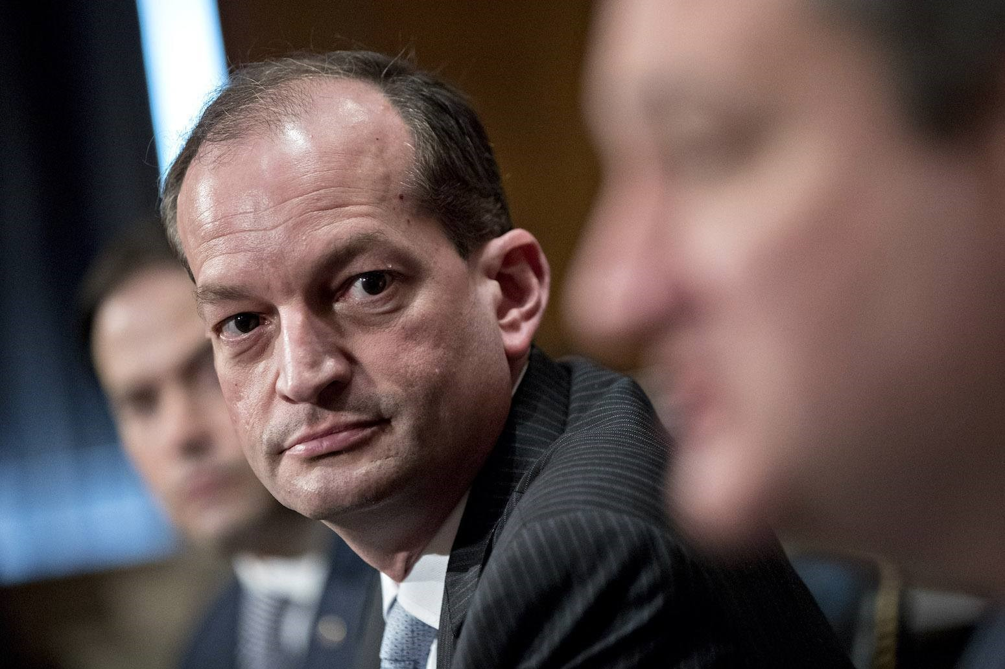
Government Relations & Advocacy

Slide 17
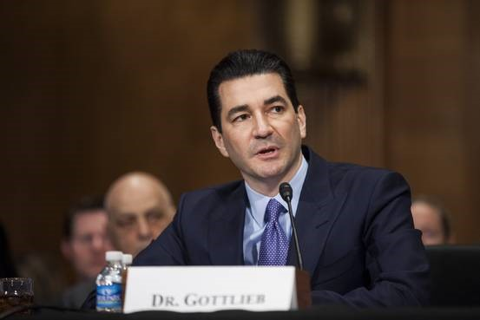
Government Relations & Advocacy

Slide 18
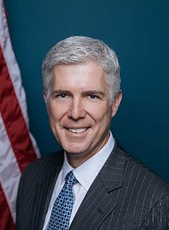
COMMERCIAL SPEECH
Government Relations & Advocacy
Justice Neil Gorsuch

Slide 19
The secret to success in the age of Trump…
Government Relations & Advocacy
Improvise
Improvise
Improvise

